Slide 1
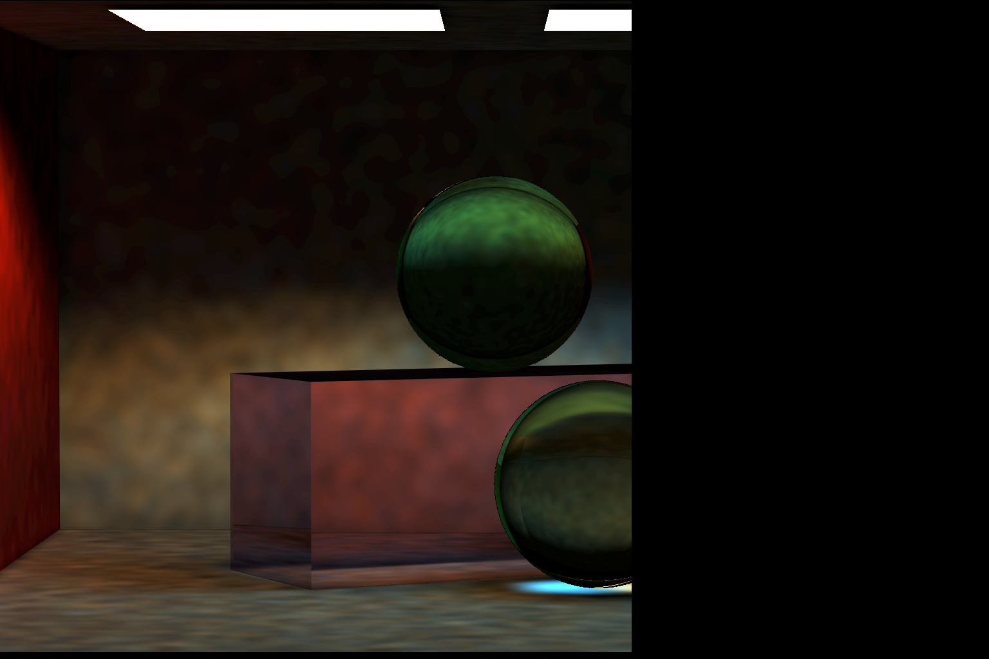
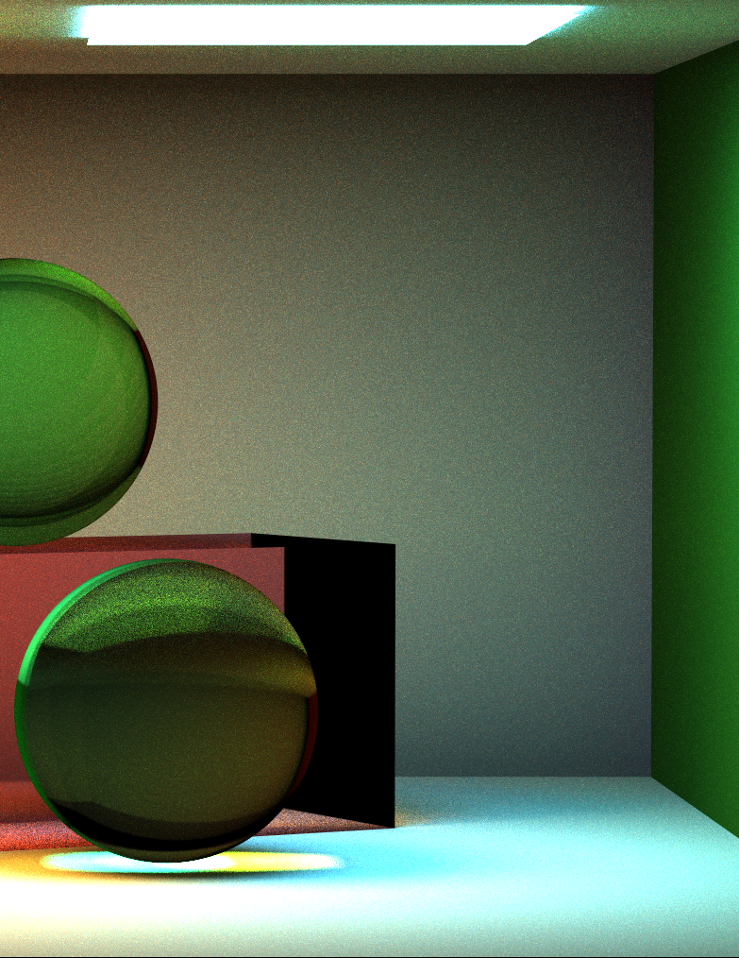
“No Time for Bottle”
By Yingjie Guo
Left
Photon Mapper
625 samples / pixel
Photon Number: 100k
Search Radius: 0.2
Photon Maps:
Direct Illumination +
Indirect Photon Map +
Caustic Photon Map
Time:~16h
Right
Full Lighting
625 samples / pixel
Time:~6h

Slide 2
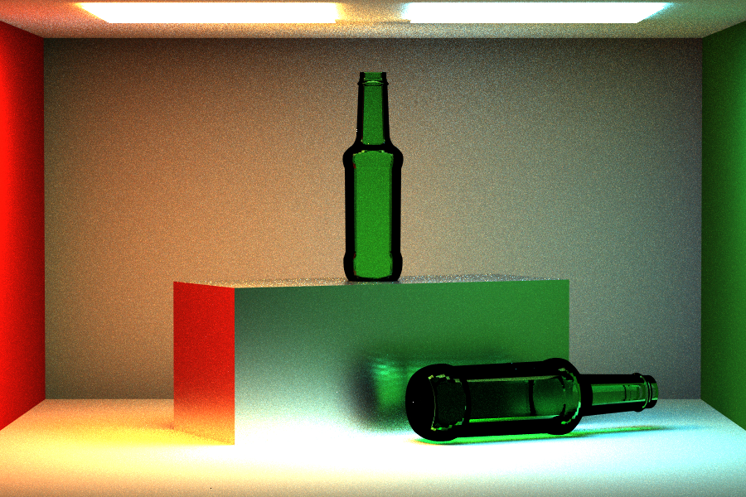
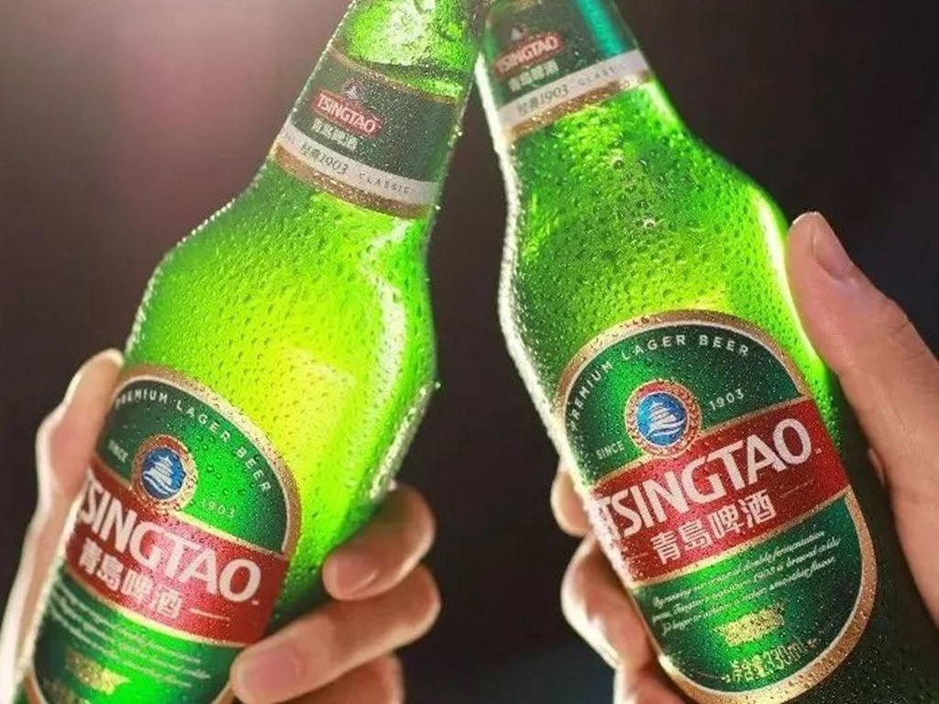
“Empty Beer Bottle”
Sliver Long Cube
Green Glass Bottle
Full Lighting
900 samples / pixel
Time: ~36h
(one day one sleep)
By Yingjie Guo

Slide 3
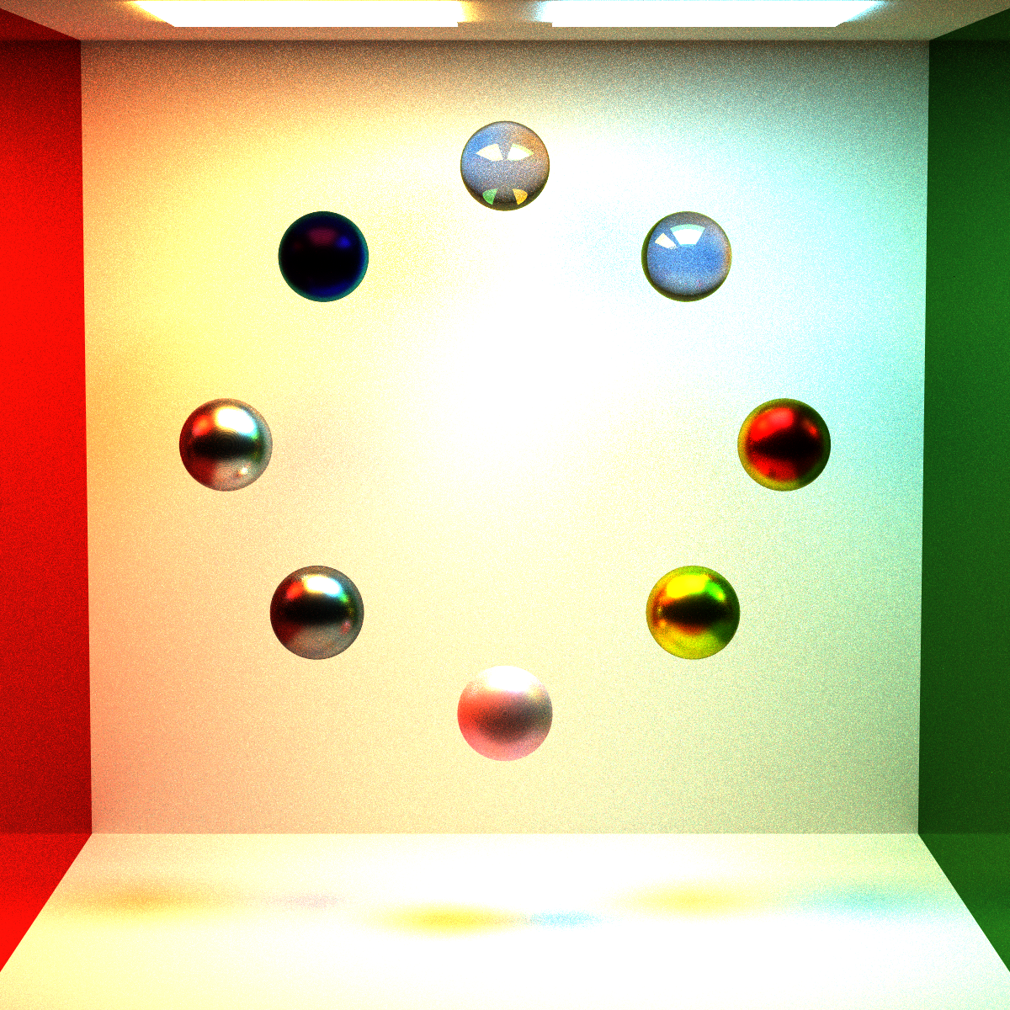
“Metal, Plastic, and Glass”
Glass
n = 1.55
Iron (Oxidized)
Green Mirror Wall
Sliver
Copper
Gold
Plastic Pink
Full Lighting
625 samples / pixel
Time: ~14h
By Yingjie Guo
Red Mirror Wall

